Slide 1
Medical AI
Lee DongNyoung
Sohaib Abdullah
Pham Van Linh
GROUP 2

Slide 2
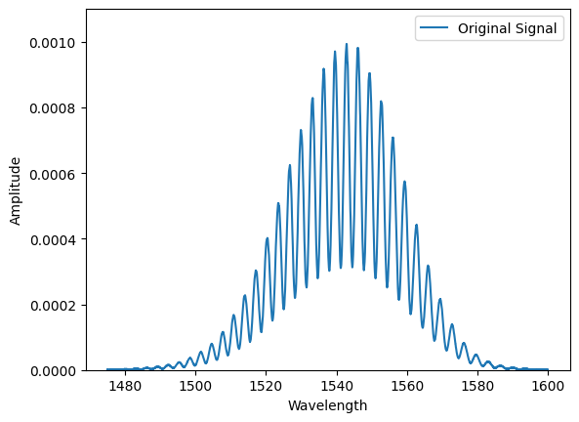
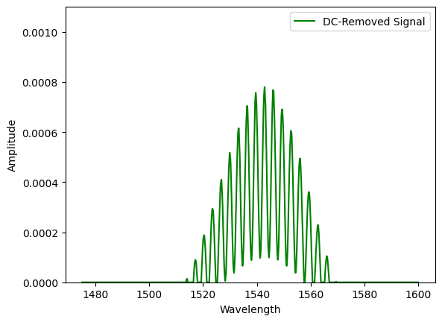
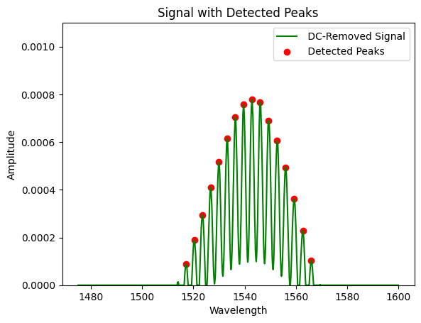
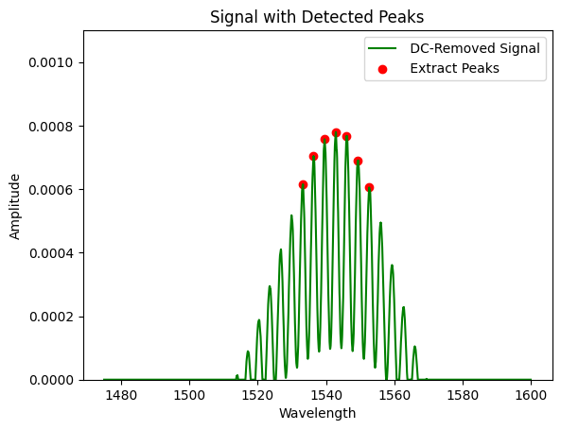
Features from single data
1
2
3
4

Slide 3

stack whole data
Single data
[x₁ x₂ x₃ x₄ x₅ y₁ y₂ y₃ y₄ y₅]
[ ]
Whole data
[x₁ x₂ x₃ x₄ x₅ y₁ y₂ y₃ y₄ y₅] ₁
[x₁ x₂ x₃ x₄ x₅ y₁ y₂ y₃ y₄ y₅] ₂
………………………………
[x₁ x₂ x₃ x₄ x₅ y₁ y₂ y₃ y₄ y₅] ₂₅₀
[x₁ x₂ x₃ x₄ x₅ y₁ y₂ y₃ y₄ y₅] ₂₅₁

Slide 4
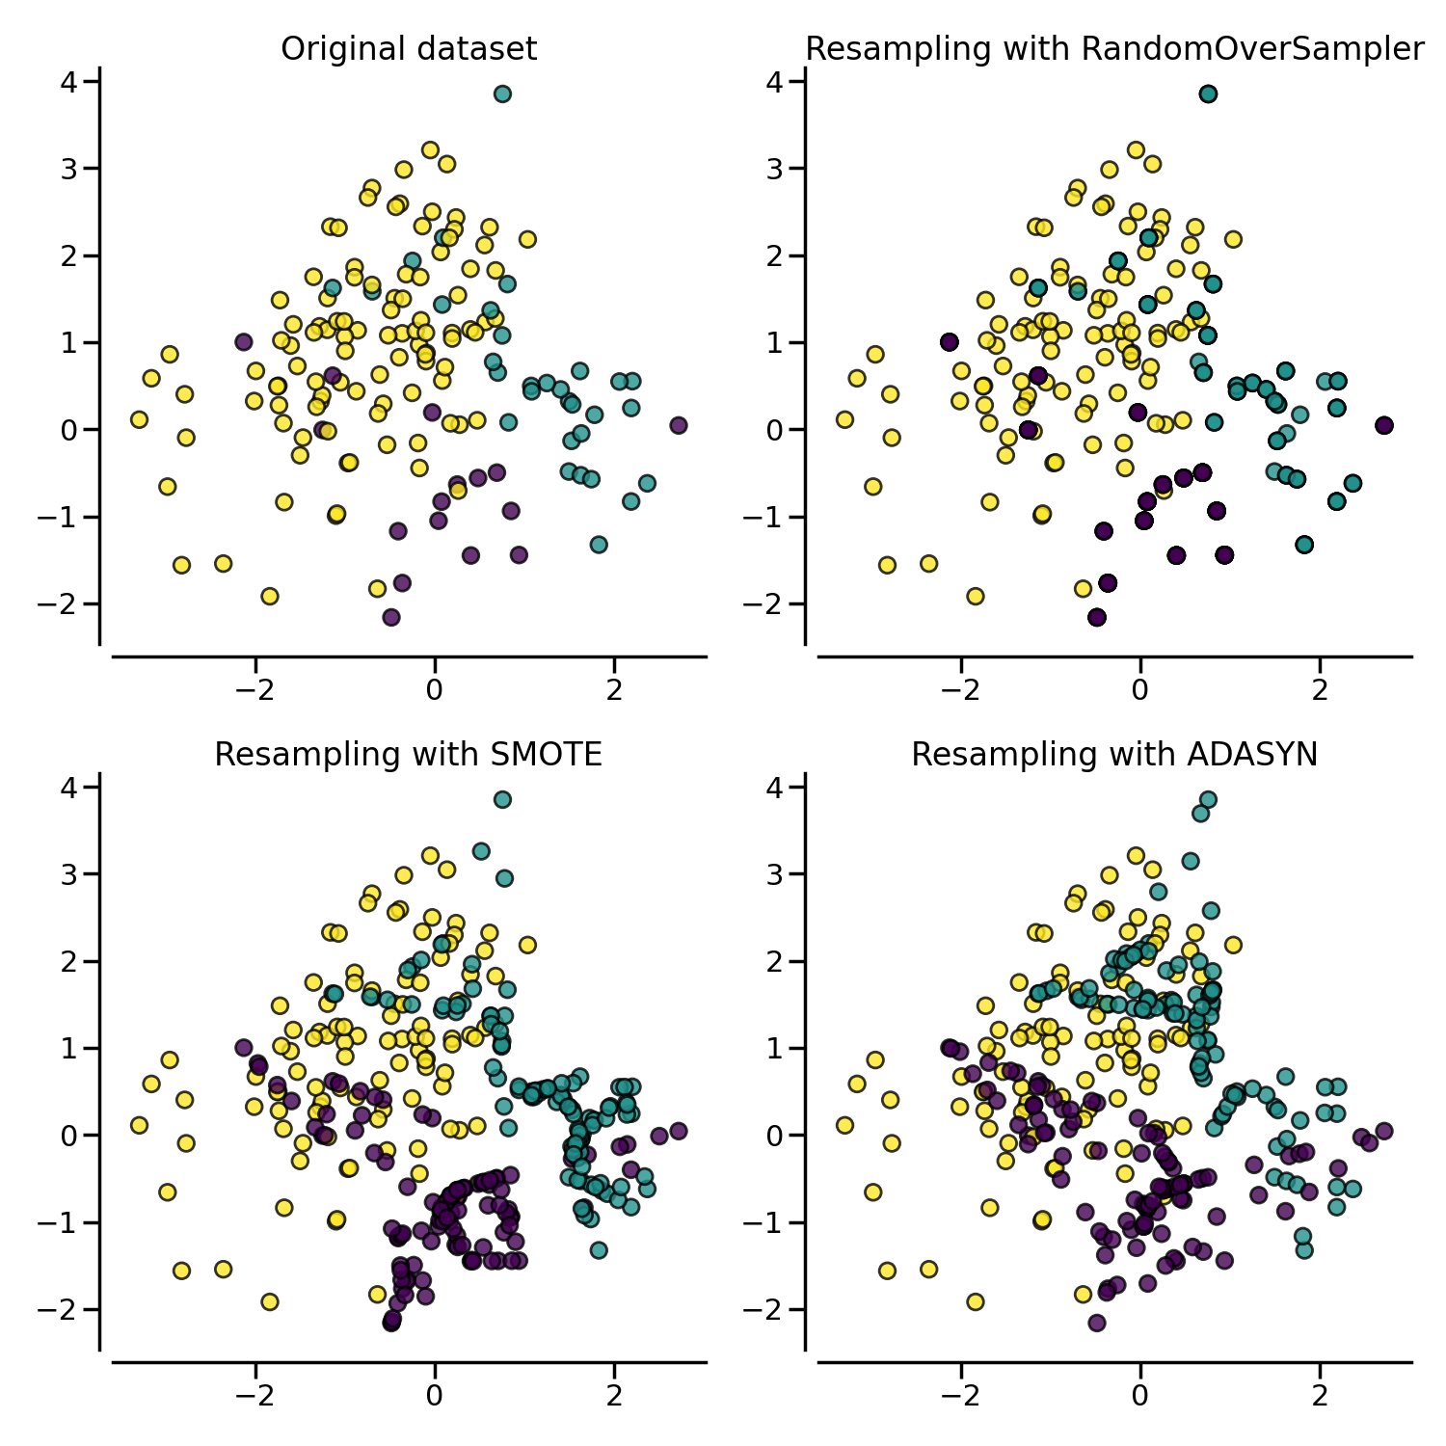
Balancing dataset
label 4: 144
label 2: 72
label 3: 12
label 1: 12
label 0: 11
label 4: 144
label 2: 144
label 3: 144
label 1: 144
label 0: 144

Slide 5
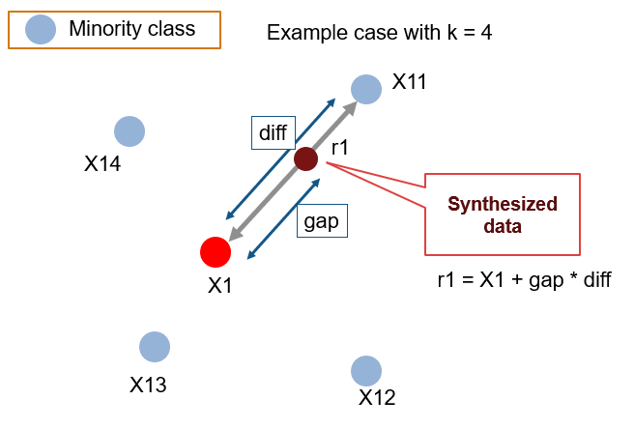
Balancing dataset
label 4: 144
label 2: 72
label 3: 12
label 1: 12
label 0: 11
label 4: 144
label 2: 144
label 3: 144
label 1: 144
label 0: 144

Slide 6
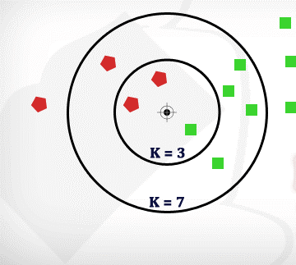
CLASSIFICATION: K-NEAREST NEIGHBORS
K-NEAREST NEIGHBORS
It makes predictions based on the majority class of its k nearest neighbors in feature space.
Non-parametric, doesn't make assumptions about the underlying data distribution.
It's versatile and can be used for classification and regression tasks.
Performance can be sensitive to the choice of k and the distance metric used.

Slide 7
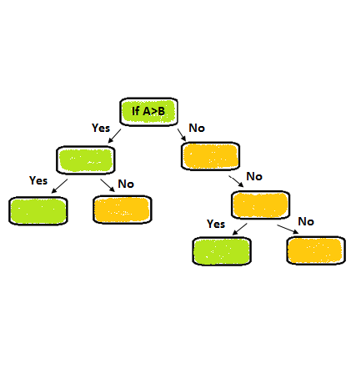
CLASSIFICATION: Decision tree
DECISION TREE
Splits the data into subsets based on features to create a tree-like structure of decisions.
Each node represents a decision based on a feature, leading to the classification of instances.
Decision trees are interpretable and easy to visualize, useful for understanding the decision-making process.
However, they can overfit the training data and may not generalize well to unseen data.

Slide 8
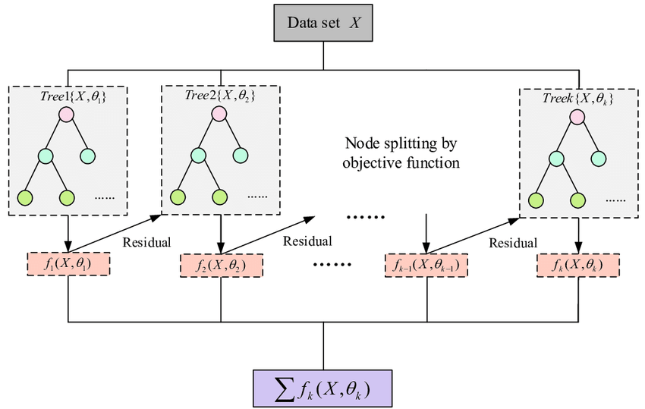
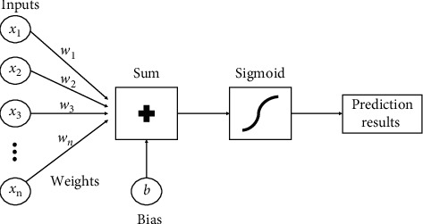
CLASSIFICATION: xgboost model
XGBOOST MODEL
XGBoost is a fast and powerful machine learning algorithm.
It combines weak models to create a stronger one.
Efficient for large datasets, it uses parallel and distributed computing.
Flexible hyperparameters allow for fine-tuning.
Widely used for its accuracy and scalability.

Slide 9
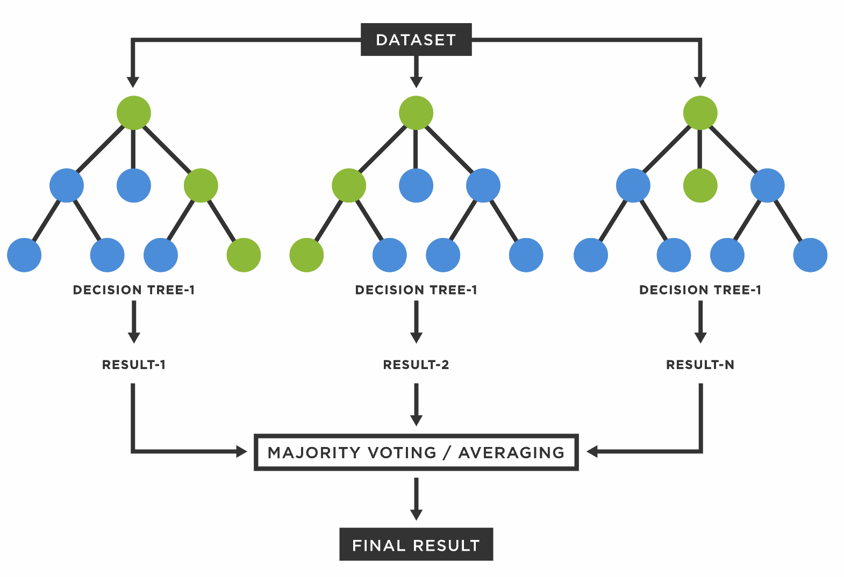
CLASSIFICATION: Random forest
RANDOM FOREST
Constructs multiple decision trees during training and outputs the mode of the classes (classification) or the mean prediction (regression) of the individual trees.
Be robust against overfitting and perform well on a variety of datasets.
Can handle both categorical and numerical data and provide feature importance scores.

Slide 10
CLASSIFICATION: RESULTS
Accuracy
Parameter weight
Decision tree

Slide 11
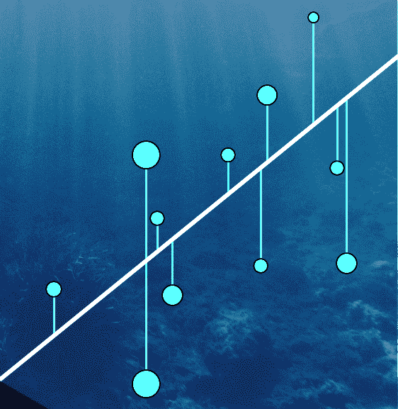
Regression: Random forest
Regression models the relationship between variables.
It assumes a linear relationship.
It aims to minimize the difference between observed and predicted values.
Parameters like slope and intercept are estimated.
Widely used in predictive modeling and understanding correlations.

Slide 12
regression: RESULTS
Root Mean Quared Error (RMSE)

